Slide 1

ICT 581 HTML5 and CSS3 with jQuery
Continuing Education
Day 4: Introduction to React.js
Mostafa Mohamed, PhD, P.Eng.
Adjunct Professor,
Electrical and Software Engineering Department
Mostafa.Mohamed@ucalgary.ca
@ 2022

Slide 2
Previous Class
Ajax and Data Formats (XML, JSON)
HTML forms
jQuery Events

Slide 3
Agenda
Introduction to React.js
Development environment
React elements, syntax and first React scripts
Reading:
https://reactjs.org/docs/getting-started.html
https://www.taniarascia.com/getting-started-with-react/

Slide 4
Introduction to React.js

Slide 5
What is React.JS
A JavaScript library for building user interfaces
HTML
Contents
Style
Behavior
CSS
JavaScript
Flash
jQuery
Behavior Lib
Frontend Lib/Frmwrk
React.js
Angular.js
Vue.js
Libraries

Slide 6
React prerequisites
Basic familiarity with HTML & CSS
Basic knowledge of JavaScript
Basic understanding of the DOM

Slide 7
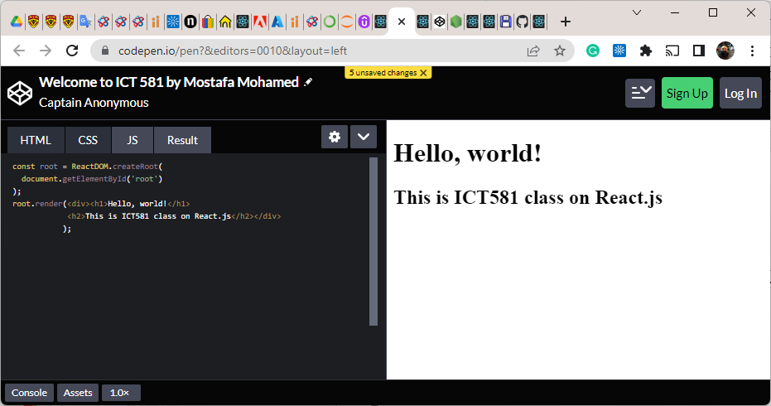
Online Playgrounds
Online code playgrounds are easy way to try React coding online without any tools or installations
Try a Hello World React.js on CodePen, CodeSandbox, or Stackblitz.

Slide 8
Using React
React can be used in two way:
Added directly to HTML page as linked scripts
Create a React project using a toolchain
Adding to an HTML file is a good option for small components that needed for existing application such as WordPress website. It has slow performance as the processing is don on the client browser when the user open the page
Using a React is recommended for a next level application as presented later. This method will need a development environment to develop on it

Slide 9
1- Adding React component to an HTML page

Slide 10
Adding React component to an HTML page
No installations required.
We will create an HTML file and link the needed scripts to it, them add a React component to the page

Slide 11
The hosting HTML page
Create a new, or use an existing HTML page
Add these script tags to the page, better to be right before the </body>:
<script src="https://unpkg.com/react@16/umd/react.development.js"></script>
<script src="https://unpkg.com/react-dom@16/umd/react-dom.development.js"></script>
<script src="https://unpkg.com/babel-standalone@6.26.0/babel.js"></script>
React is the main react library which defines its methods and types
React-DOM has tools to link your react components to the HTML
Babel is a JavaScript compiler to compile ES6 JS, code used by React, to vanilla JS for older browsers, also to compile JSX code

Slide 12
Add the Container HTML element
We need to add an HTML element to the HTML page
This element will be the container for our new React component
Add this div anywhere in the HTML body:
<div id="my_react_component_container"></div>
We can have as many containers in the same page

Slide 13
Create the React component
Add this script section after the previous script tags (just before the </body>)
<script type="text/babel"> // text/babel is needed for the Babel compiler
class App extends React.Component {
render() {
return <h1>Hello world! from ICT 581!</h1>
}
}
// The below code renders the React component in hour HTML element const domContainer = document.getElementById('my_react_component_container');
const root = ReactDOM.createRoot(domContainer);
root.render(React.createElement(App));
</script>

Slide 14
Activity
Create an HTML page to show your personal information using a React.js component
The component should display your Name, email, and interests
The display should be in a table form with nice CSS formatting

Slide 15
Preparing the Development Environment

Slide 16
The environment
These tools are optional for simple application development, but are needed if you are developing beyond basic
Node.js is needed to use toolchains to compile React.js applications for better performance and integration with other Node.js libraries

Slide 17
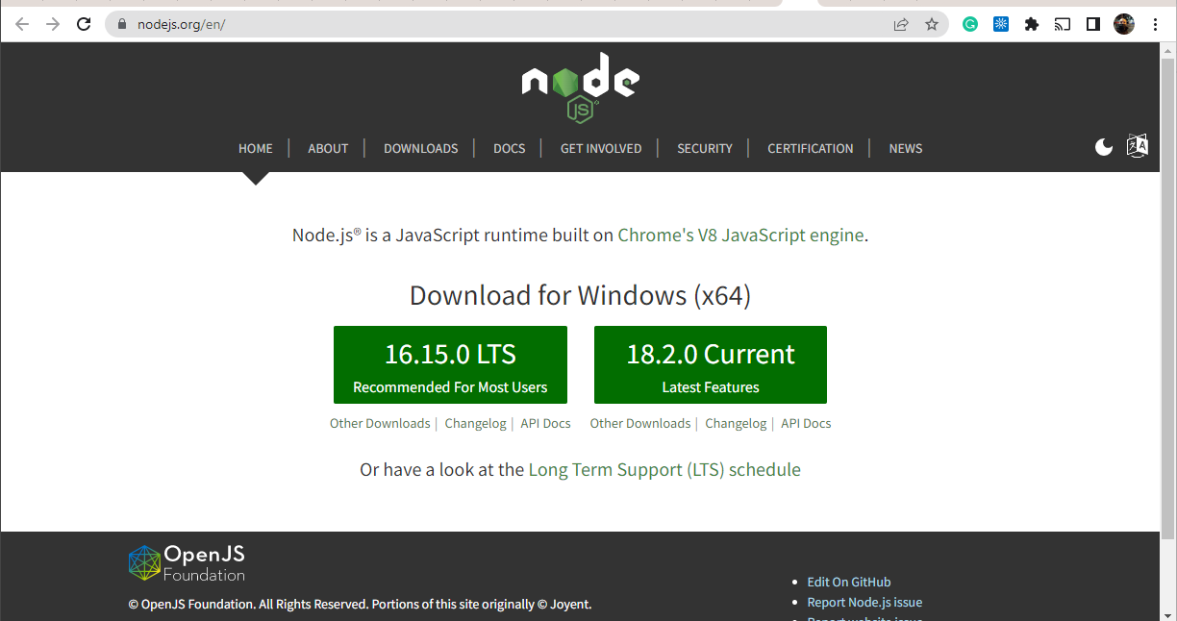
Install Node.js
Node.js is a JavaScript framework used to develop JavaScript based projects using toolchain
We need Node.js to build our React.js components
Install Node.js from https://nodejs.org/en/
It can run on Windows, MAC and Linux
This is optional for now

Slide 18
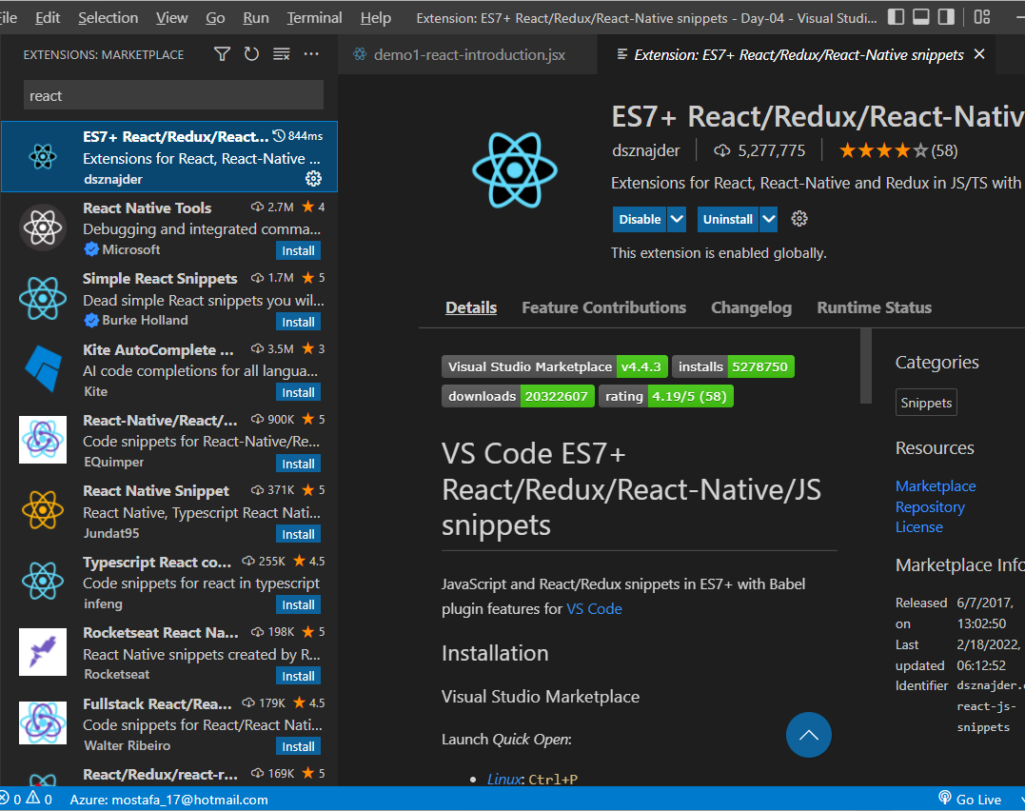
Install VS Code Extension
Optional
Install VS Code Extension: ES7+ React/Redux/React-Native snippets
It has many code snippets that can help in developing React
To activate: ctr+alt+r and select the command you want

Slide 19
React Developer Tools
Is a browser extension you can install on Chrome or Firefox to inspect React components and its states
React Developer Tools - Chrome Web Store (google.com)
React Developer Tools –🦊 Firefox (mozilla.org)
Right-click on the React page, click “Inspect”, the React tabs (“⚛️ Components” and “⚛️ Profiler”) will appear as the last tabs to the right.

Slide 20
2- Create React Application

Slide 21
React toolchains
React toolchains help with tasks like:
Use many files and components to build you applications
Using third-party libraries from npm
Detecting common mistakes early
Editing CSS and JS in development.
Optimizing the output for production
There are many toolchains you can chose from. We are going to use the create-react-app
More information can be found here: https://reactjs.org/docs/create-a-new-react-app.html

Slide 22
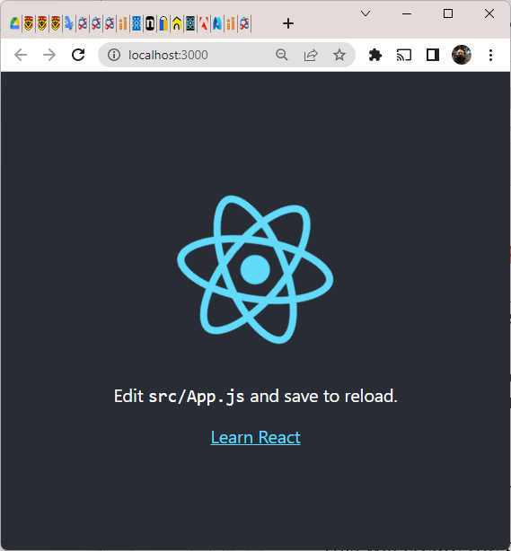
Create React App
Is a tool you can use to quickly create a SINGLE page react application
It add starting project template files, installs needed libraries and tools for your project
To create a project run:
npx create-react-app <your application name>
cd <your application name>
npm start
This will create the project, run a development server with auto-reload on file save, and opens the browser on the starting page

Slide 23
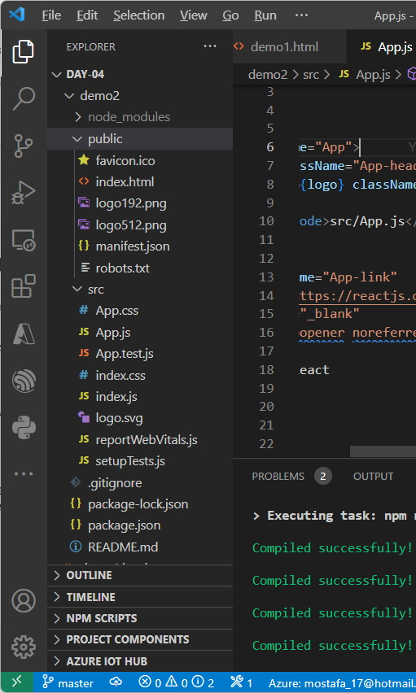
The React Application Template
The generated template has:
The public folder with static web contents
src folder with the main React codes
.gitignore file for source control
package.json and package-lock.json which have Node.js the project configuration information
Readme.md readme file
Node_modules folder which has the installed Node.js packages for the project

Slide 24
Summary
Introduction to React.js
Development environment
React elements, syntax and first React scripts

Slide 25
Activity
Create a React Application to show your personal information using a React.js component
The component should display your Name, email, and interests
The display should be in a table form with nice CSS formatting

Slide 27
Thank you for attending today!!!
Mostafa Mohamed, PhD, P.Eng.
Mostafa.Mohamed@ucalgary.ca
WhatsApp: 403-966-8112

